Slide 1

VALLURUPALLI NAGESWARA RAO VIGNANA JYOTHI INSTITUTE OF ENGINEERING AND TECHNOLOGY
Department of Computer Science and Engineering
Decision Tree
MACHINE LEARNING
BTech CSE (III Year-II Sem)
Dr. Kriti Ohri
Assistant Professor
Department of Computer Science and Engineering

Slide 2
Decision Tree
(Machine Learning Algorithm)

Slide 3
Introduction
Classification is one form of data analysis that can be used to extract models describing important data classes or to predict future data trends
Classification predicts categorical (discrete, unordered) labels whereas Regression analysis is a statistical methodology that is most often used for numeric (continuous) prediction
For example, we can build a classification model to categorize bank loan
applications as either safe or risky
Regression model is used to predict expenditures in dollars of potential
customers on computer equipment given their income and occupation

Slide 4
What is a decision tree
A decision tree is a map of the possible outcomes of a series of related choices. It allows an individual or organization to weigh possible actions against one another based on their costs, probabilities, and benefits.
As the name goes, it uses a tree-like model of decisions. They can be used either to drive informal discussion or to map out an algorithm that predicts the best choice mathematically.
A decision tree typically starts with a single node, which branches into possible outcomes. Each of those outcomes leads to additional nodes, which branch off into other possibilities. This gives it a tree-like shape.

Slide 5
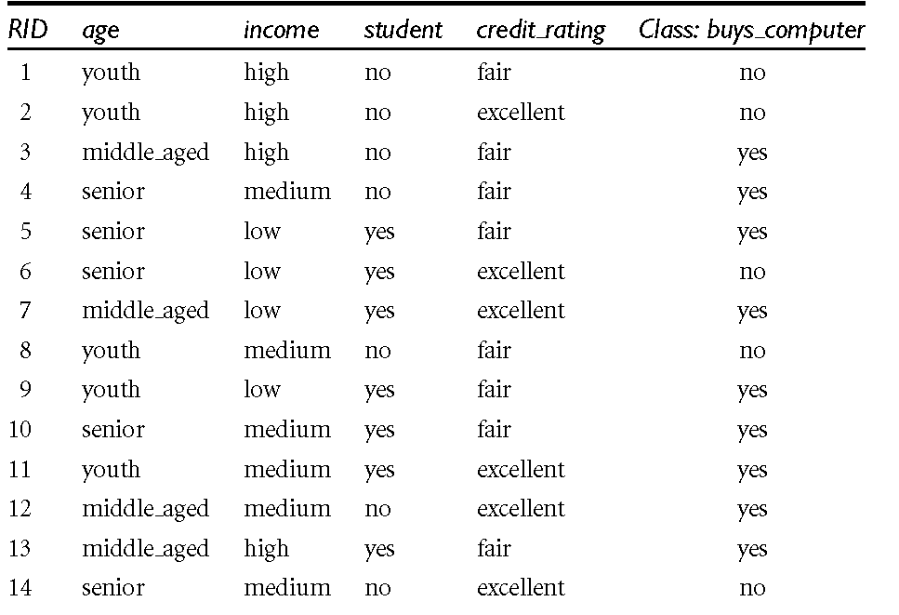
Problem Description for Illustration

Slide 6


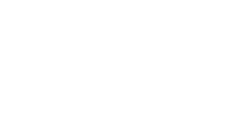



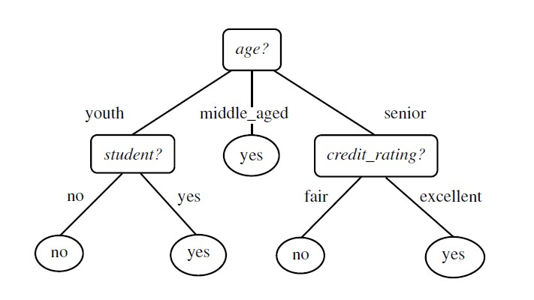


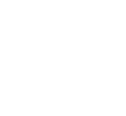
Root Node, Internal Node, leaf Node
Root Node or parent node
A decision tree uses a tree structure to represent a number of possible decision paths and an outcome for each path
A decision tree consists of root node, internal node and leaf node
The topmost node in a tree is the root node
or parent node
It represents entire sample population
Internal node (non-leaf node) denotes a test on an attribute, each branch represents an outcome of the test
Leaf node (or terminal node) holds a class label
It can not be further split
child Node
leaf Node

Slide 7
Root Node, Internal Node, leaf Node
Root Node or parent node
child Node
leaf Node
age | income | student | Credit rating | Buys comp
Senior | low | no | fair | ?

Slide 8
Root Node, Internal Node, leaf Node
Root Node or parent node
age | income | student | Credit rating | Class-buys computer
youth | high | No | fair | No
youth | high | No | excellent | No
youth | Medium | No | fair | No
youth | Low | Yes | fair | yes
youth | medium | yes | excellent | Yes
child Node
age | income | student | Credit rating | Class-buys computer
youth | high | No | fair | No
youth | high | No | excellent | No
youth | Medium | No | fair | No
leaf Node

Slide 9
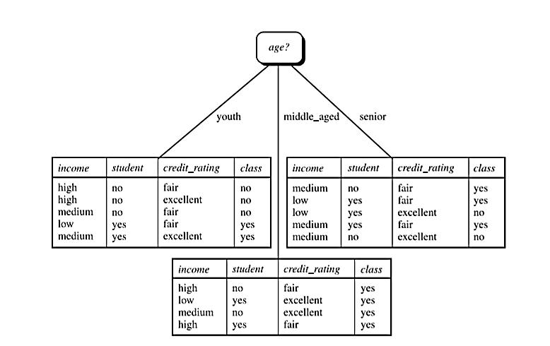
Decision tree

Slide 10
To give loan or not
Employed?
No
Yes
Credit score
income
High
Low
High
Low
approve
reject
approve
reject

Slide 11
Decision Tree Representation
Good day for tennis?
Leaves = classification
Arcs = choice of value
for parent attribute
Outlook
Sunny
Rain
Overcast
Humidity
Wind
Play
Strong
Weak
High
Normal
Don’t play
Play
Don’t play
Play

Slide 12
Experience: “Good day for tennis”
Day Outlook Temp Humid Wind PlayTennis?
d1 s h h w n
d2 s h h s n
d3 o h h w y
d4 r m h w y
d5 r c n w y
d6 r c n s n
d7 o c n s y
d8 s m h w n
d9 s c n w y
d10 r m n w y
d11 s m n s y
d12 o m h s y
d13 o h n w y
d14 r m h s n

Slide 13
Numeric Attributes
Use thresholds to convert numeric attributes into discrete values
Outlook
Sunny
Rain
Overcast
Humidity
Wind
Play
>= 10 MPH
< 10 MPH
>= 75%
< 75%
Don’t play
Play
Don’t play
Play

Slide 14
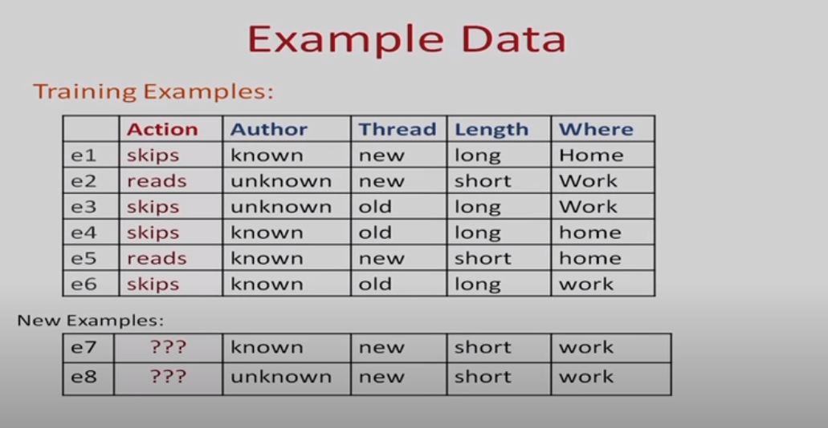

Slide 15
Possible Splits
Skips 4
Reads 2
Skips 4
Reads 2
Length
Thread
long
short
new
old
Skips 4
Reads 0
Skips 0
Reads 2
Skips 1
Reads 2
Skips 3
Reads 0
Split on length is good than Thread

Slide 16
When to stop
-No more input feature
-All examples are classified as same
-Too few examples to make an informative split

Slide 17
Decision Tree
A decision tree for the concept buys_computer, indicating whether a customer at All Electronics is likely to purchase a computer
Each internal (non-leaf) node represents a test on an attribute
Each leaf node represents a class (either buys_computer = yes or buys computer = no).
Figure 1.1 : Decision Tree

Slide 18
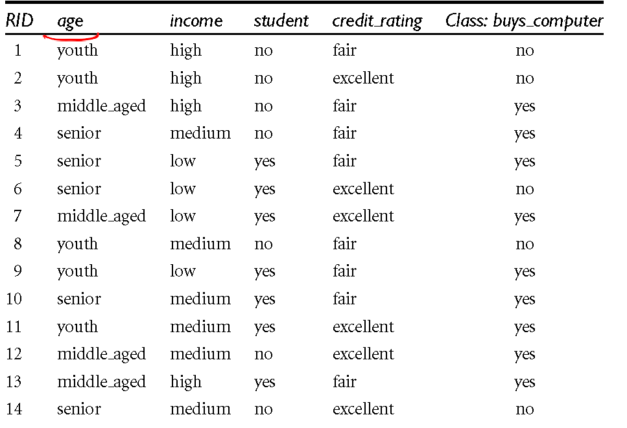
Decision Tree Algorithm
Input:
Data partition, D, which is a set of training tuples and their associated class labels;
Attribute list, the set of candidate
attributes;
Attribute selection method, a procedure to determine the splitting criterion that “best” partitions the data tuples into individual classes. This criterion consists of a splitting attribute and, possibly, either a split point or splitting subset.
Output: A decision tree

Slide 19
Decision Tree Algorithm
The algorithm is called with three parameters: D, attribute list, and Attribute selection method
D is defined as a data partition. Initially, it is the complete set of training tuples and their associated class labels
The parameter attribute list is a list of attributes or independent variables
which are describing the tuples
Attribute selection method specifies a heuristic procedure for selecting the attribute that “best” discriminates the given tuples according to class

Slide 20
Decision Tree Algorithm
This procedure employs an attribute selection measure, such as information gain, gain ratio or the Gini index.
Whether the tree is strictly binary is generally driven by the attribute selection measure
Some attribute selection measures, such as the Gini index, enforce the resulting tree to be binary. Others, like information gain, do not, therein allowing multiway splits (i.e., two or more branches to be grown from a node).

Slide 21
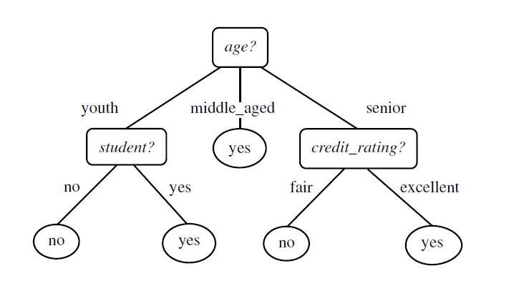
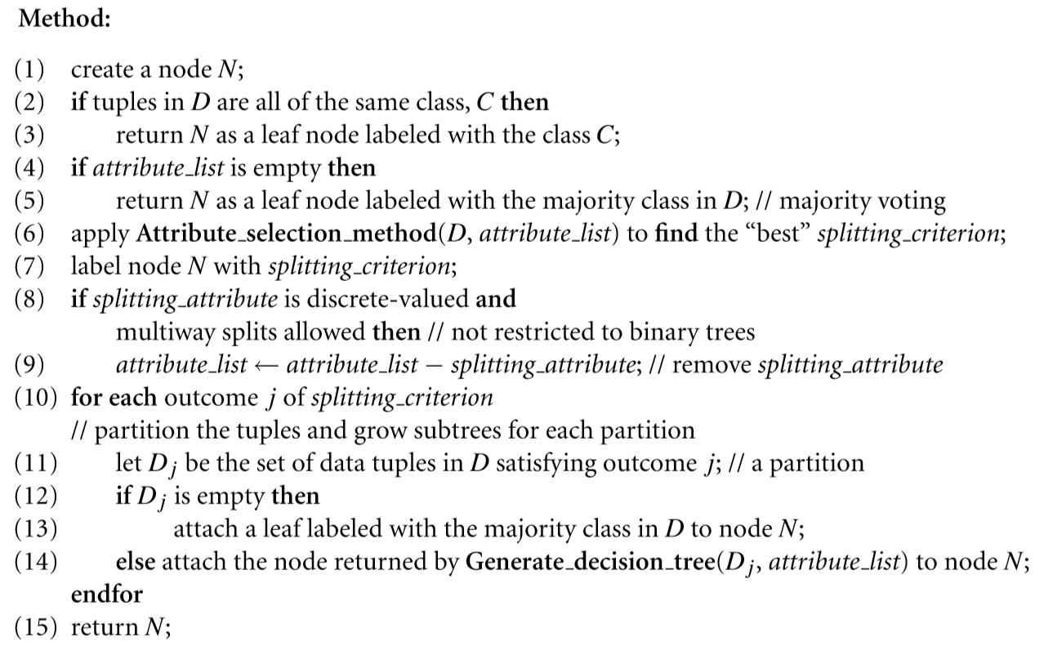
Decision Tree Method
Training data (D)
N
N-Node C- Class
D- tuples in training data set

Slide 22

Decision Tree Method step 1 to 6
The tree starts as a single node, N, representing the training tuples in D (step 1).
If the tuples in D are all of the same class, then node N becomes a leaf and is labelled with that class (steps 2 and 3)
Steps 4 and 5 are terminating conditions
Otherwise, the algorithm calls Attribute selection method to determine the splitting criterion
The splitting criterion tells us which attribute to test at node N by determining the “best” way to separate or partition the tuples in D into individual classes (step 6)

Slide 23
Decision Tree Method step 1 to 6
Training data (D)
The tree starts as a single node, N, representing the training tuples in D (step 1).
If the tuples in D are all of the same class, then node N becomes a leaf and is labelled with that class (steps 2 and 3)
Steps 4 and 5 are terminating conditions
Otherwise, the algorithm calls Attribute selection method to determine the splitting criterion
The splitting criterion (like information gain) tells us which attribute to test at node N by determining the “best” way to separate or partition the tuples in D into individual classes (step 6)
N

Slide 24

Decision Tree Method - Step 7 - 11
The splitting criterion indicates the splitting attribute and may also indicate either a split-point or a splitting subset
The splitting criterion is determined so that, ideally, the resulting partitions at each branch are as “pure” as possible. A partition is pure if all of the tuples in it belong to the same class.
The node N is labelled with the splitting criterion, which serves as a test at the node (step 7).
A branch is grown from node N for each of the outcomes of the splitting criterion.
The tuples in D are partitioned accordingly
(steps 10 to 11)

Slide 25
Decision Tree Method – termination condition
• The algorithm uses the same process recursively to form a decision tree
for the tuples at each resulting partition, Dj, of D (step 14).
• The recursive partitioning stops only when anyone of the following
terminating conditions is true:
1. All of the tuples in partition D (represented at node N) belong to the
same class (steps 2 and 3), or

Slide 26
2. There are no remaining attributes on which the tuples may be further
partitioned (step4).
• In this case, majority voting is employed(step 5).
• This involves converting node N into a leaf and labelling it with the most
common class in D.
• Alternatively, the class distribution of the node tuples may be stored.
3. There are no tuples for a given branch, that is, a partition Dj is empty (step
12).
• In this case, a leaf is created with the majority class in D (step 13).
• The resulting decision tree is returned (step 15).

Slide 27
ID3 algorithm
ID3 stands for Iterative Dichotomiser 3 and is named such because the algorithm iteratively (repeatedly) dichotomizes(divides) features into two or more groups at each step.
Invented by Ross Quinlan, ID3 uses a top-down greedy approach to build a decision tree. In simple words, the top-down approach means that we start building the tree from the top and the greedy approach means that at each iteration we select the best feature at the present moment to create a node.
Most generally ID3 is only used for classification problems with nominal features only.

Slide 28
ID3 algorithm
ID3 algorithm, stands for Iterative Dichotomiser 3, is a classification algorithm that follows a greedy approach of building a decision tree by selecting a best attribute that yields maximum Information Gain (IG) or minimum Entropy (H).
• Discrete features, cannot handle numeric features
• Multi-category splits
• Prone to overfitting
• Maximizes information gain/minimizes entropy
• Discrete features, binary and multi-category features

Slide 29
Top Down Induction of Decision Tree ID3
ID3 stands for Iterative Dichotomiser 3
Which node to proceed with-based on a selection measure
Based on that assign A as decision attribute for node.
For each value of A create a new descendent
Sort training examples to a leaf node according to the attribute value of branch
If all training examples are perfectly classified (same value of target attribute) stop else iterate over new leaf node.

Slide 30
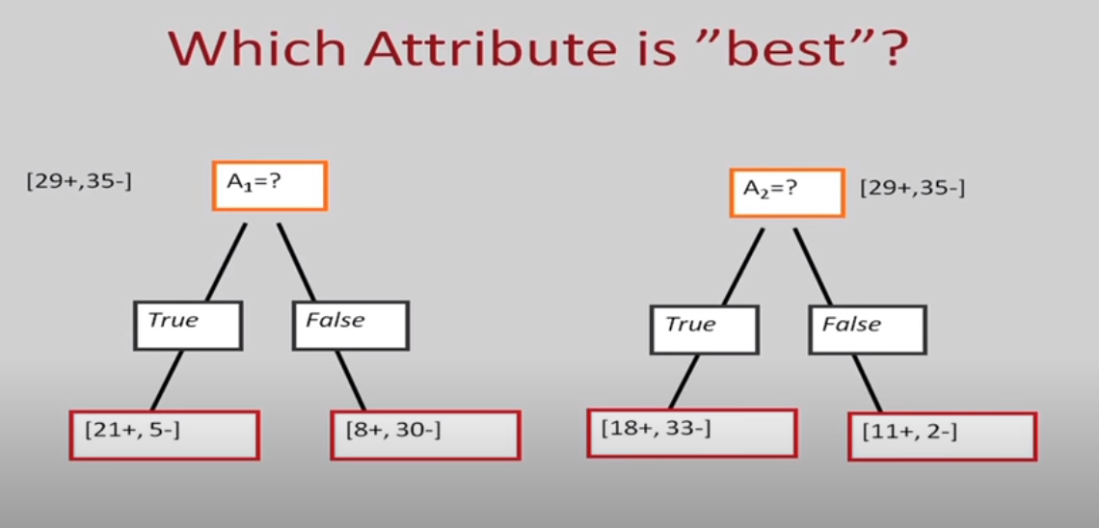
Which attribute is the best

Slide 31
Attribute Selection Measures
Attribute selection measures are also known as splitting rules because they determine how the tuples at a given node are to be split
It is a heuristic approach for selecting the splitting criterion that “best” separates a given data partition, D, of class-labeled training tuples into individual classes
The attribute selection measure provides a ranking for each attribute
describing the given training tuples
The attribute having the best score for the measure is chosen as the
splitting attribute for the given tuples

Slide 32
Attribute Selection Measures
If the splitting attribute is continuous-valued or if we are restricted to binary trees then, respectively, either a ‘split point’ or a ‘splitting subset’ must also be determined as part of the splitting criterion
There are three popular attribute selection measures
  information gain
  gain ratio, and
  Gini index

Slide 33
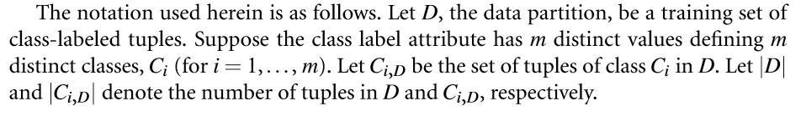
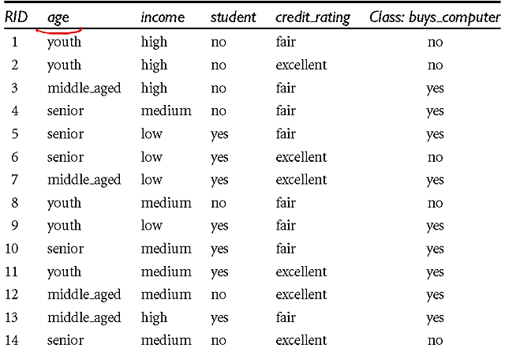
Attribute Selection Measures

Slide 34
Information Gain
This measure studied the value or “information content” of messages
The attribute with the highest information gain is chosen as the splitting attribute for node
This attribute minimizes the information needed to classify the tuples in the resulting partitions and reﬂects the least randomness or “impurity” in these partitions
This approach minimizes the expected number of tests needed to classify a given tuple

Slide 35
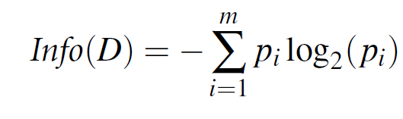
Information or Entropy
The expected information needed to classify a
tuple in D is given by
Where 𝑝_{𝑖} is the probability that an arbitrary tuple in D belongs to class 𝐶_{𝑖}and is estimated by |𝐶_{𝑖,𝐷} |/|D|.
A log function to the base 2 is used, because the information is encoded in bits
Info(D) (or Entropy of D )is just the average amount of information needed to identify the class label of a tuple in D

Slide 36
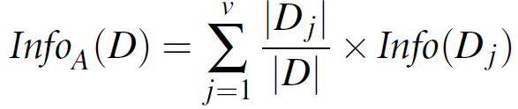
Attribute Selection Measures
It is quite likely that the partitions will be impure (e.g., where a partition may contain a collection of tuples from different classes rather than from a single class).
How much more information would we still need (after the partitioning) in order to arrive at an exact classification?
This amount is measured by
The term |𝐷_{𝑗}| / |D| acts as the weight of the 𝑗_{𝑡ℎ} partition. 𝐼𝑛𝑓𝑜_{𝐴} (D) is the expected information required to classify a tuple from D based on the partitioning by A.

Slide 37

Information Gain
The smaller the expected information (still) required, the greater the purity of the partitions
Information gain is defined as the difference between the original information requirement (i.e., based on just the proportion of classes) and the new requirement (i.e., obtained after partitioning on A). That is,
The attribute A with the highest information gain, (Gain(A)), is chosen as
the splitting attribute at node N.

Slide 38
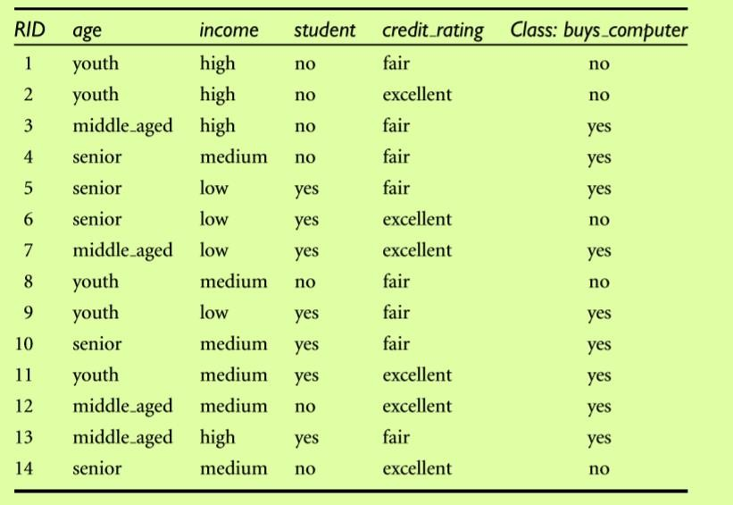
Example
The following Table presents a training set, D, of class- labeled tuples randomly selected from the AllElectronics customer database
Han, J., Pei, J. and Kamber, M., 2011. Data mining: concepts and techniques. Elsevier.

Slide 39
Example
In this example, each attribute is discrete-valued
Continuous-valued attributes have been generalized
The class label attribute, buys computer, has two distinct values (namely,
{yes, no}); therefore, there are two distinct classes (that is, m = 2)
Let class C₁ correspond to ‘yes’ and class C₂ correspond to ‘no’.
There are nine tuples of class ‘yes’ and ﬁve tuples of class ‘no’.
A (root) node N is created for the tuples in D

Slide 40


Expected information needed to classify a tuple in D
To ﬁnd the splitting criterion for these tuples, we must compute the
information gain of each attribute
Let us consider Class: buys computer as decision criteria D
Calculate information/entropy
• = -p_{y} log₂ (p_{y}) – p_{n} log₂ (p_{n})
Where p_{y} is probability of ‘yes’ and p_{n} is probability of ‘no’
Note Info/information means entropy don’t mix it with information gain

Slide 41

Calculation of entropy for ‘ Youth’
Age can be:
  youth
  Middle_aged
  Senior
Youth
Youth | Class: buys computer
Yes | 2
No | 3
Entropy youth =

Slide 42

Calculation of entropy for ‘ Youth’
Middle_aged
middle | Class: buys computer
Yes | 4
No | 0
Entropy for middle_aged
= 0

Slide 43

Calculation of entropy for ‘ Middle Age’
For Senior
Senior | Class: buys computer
Yes | 3
No | 2
Calculate Entropy for senior
=

Slide 44
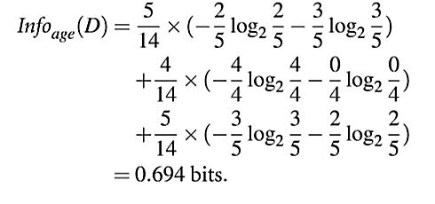
The expected information needed to classify a tuple in D according to age
The expected information needed to classify a tuple in D if the tuples are partitioned according to age is

Slide 45
Calculation information Gain of Age
Gain of Age:

Slide 46
Calculation information Gain of Income
Calculation of gain for income:
Income cane be:
  High
  Medium
  Low

Slide 47
Calculate Entropy for high
High :
High | Class: buys computer
Yes | 2
No | 2
Calculate Entropy for high:
= -(2/4)log₂(2/4) - (2/4)log₂(2/4)

Slide 48
Calculate Entropy for ‘medium’
Medium:
Medium | Class: buys computer
Yes | 4
No | 2
Calculate Entropy for Medium:
= -(4/6)log₂(4/6) - (2/6)log₂(2/6)

Slide 49
Calculate Entropy for ‘low’
Low :
Low | Class: buys computer
No | 1
Yes | 3
Calculate Entropy for Low:
= -(1/4)log₂(1/4) - (3/4)log₂(3/4)

Slide 50
Gain of income
The expected information needed to classify a tuple in D if the tuples are partitioned according to income is:
Info _{income} (D) = (4/14) ( -(2/4)log₂(2/4) - (2/4)log₂(2/4)) +
(6/14) ( -(4/6)log₂(4/6) - (2/6)log₂(2/6)) +
(4/14) -(1/4)log₂(1/4) - (3/4)log₂(3/4)
= 0.911
Gain of income : Info(D) - Info _{income} (D)
= 0.94 – 0.911 = 0.029

Slide 51
Calculation of gain for student
Calculation of gain for student
Student can be:
  Yes
  No

Slide 52
Calculate Entropy for No
No :
No | Class: buys computer
Yes | 3
No | 4
Calculate Entropy for No:
= -(3/7)log₂(3/7) - (4/7)log₂(4/7)

Slide 53
Calculate Entropy for ‘Yes’
Yes :
Yes | Class: buys computer
Yes | 6
No | 1
Calculate Entropy for Yes:
= -(6/7)log₂(6/7) - (1/7)log₂(1/7)

Slide 54
Gain of student
The expected information needed to classify a tuple in D if the tuples are partitioned according to student is:
Info _{Student} (D) = (7/14) (-(3/7)log₂(3/7) - (4/7)log₂(4/7)) +
(7/14) (-(6/7)log₂(6/7) - (1/7)log₂(1/7))
=0.789
  Gain(student) :
Info(D) - Info _{student} (D)
= 0.94 – 0.789 = 0.151

Slide 55
Calculation of gain for credit rating
Calculation of gain for credit rating
Credit rating can be:
  Fair
  Excellent

Slide 56
Calculate Entropy for Fair
Fair :
Fair | Class: buys computer
Yes | 6
No | 2
Calculate Entropy for Fair:
= -(6/8)log₂(6/8) - (2/8)log₂(2/8)

Slide 57
Calculate Entropy for Excellent
Excellent :
Yes | Class: buys computer
Yes | 3
No | 3
Calculate Entropy for Excellent:
= -(3/6)log₂(3/6) - (3/6)log₂(3/6)

Slide 58
Gain for credit rating
The expected information needed to classify a tuple in D if the tuples are partitioned according to Credit rating is:
Info _{Credit rating} (D) = (8/14) (-(6/8)log₂(6/8) - (2/8)log₂(2/8)) + (6/14) (-(3/6)log₂(3/6) - (3/6)log₂(3/6))
=0.892
  Gain for credit rating :
Info(D) - Info _{Credit rating} (D)
= 0.94 – 0.892 = 0.048

Slide 59
Independent variable | Information gain
Age | 0.246
Income | 0.029
Student | 0.151
Credit_rating | 0.048

Slide 60
Selection of root classifier
Because age has the highest information gain among the attributes, it is selected as the splitting attribute
Node N is labelled with age, and branches are grown for each of the
attribute’s values
The tuples are then partitioned accordingly
Notice that the tuples falling into the partition for age = middle aged all
belong to the same class
Because they all belong to class “yes,” a leaf should therefore be created
at the end of this branch and labelled with “yes.”

Slide 61
Decision tree

Slide 62
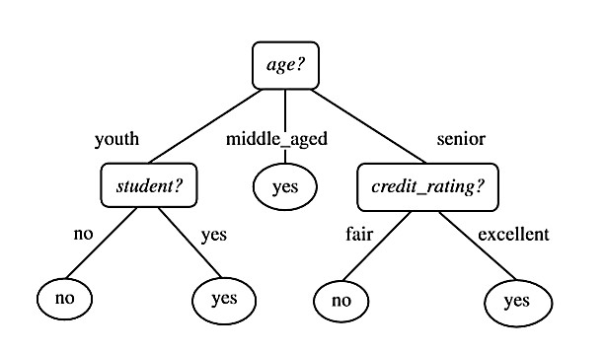
Decision tree
The ﬁnal decision tree returned by the algorithm is shown in Figure

Slide 63
Disorder is bad Homogeneity is good
No
Better
Bad
Good

Slide 64
Entropy
50-50 class split
Maximum disorder
1.0
0.5
All positive
Pure distribution
% of example that are positive
.00 .50 1.00

Slide 65
Information Gain
Measure of expected reduction in entropy
Resulting from splitting along an attribute
Σ
v ∈ Values(A)
Gain(S,A) = Entropy(S) - (|Sv| / |S|) Entropy(Sv)
Where Entropy(S) = -P log₂(P) - N log₂(N)

Slide 66
Issues in Decision Tree
Missing data
Real-valued attributes
Overfitting

Slide 67
Handling Missing Attribute Value
In certain cases, the available data may be missing values for some attributes. For example, in a medical domain in which we wish to predict patient outcome based on various laboratory tests, it may be that the Blood-Test-Result is available only for a subset of the patients. In such cases, it is common to estimate the missing attribute value based on other examples for which this attribute has a known value.
Consider the situation in which Gain(S, A) is to be calculated at node n in the decision tree to evaluate whether the attribute A is the best attribute to test at this decision node. Suppose that (x, c(x)) is one of the training examples in S and that the value A(x) is unknown.

Slide 68
One strategy for dealing with the missing attribute value is to assign it the value that is most common among training examples at node n. Alternatively, we might assign it the most common value among examples at node n that have the classification c(x). The elaborated training example using this estimated value for A(x) can then be used directly by the existing decision tree learning algorithm.

Slide 69
Solution for missing values
Deleting records where missing values are there but leads to loss of information
Create a model to predict missing values
Using some statistical methods: mean , median, mode (imputation)

Slide 70
Handle Missing Values in Categorical Features
1)Delete rows: but the problem is that useful information may be lost
2)Replace with the most frequent value: but the problem is unbalanced dataset within the category.
3)Create a classifier to predict the category: in this we treat the column where missing vales are there as dependent variable and all other attributes as independent variable, and we predict dependent variable with the help of independent variable. Time and computational requirements are more.
4) Use unsupervised ML algorithm

Slide 71

How to handle Real-valued Features
Discretize?
Threshold split using observed values?
Discretization (Binning):
Approach is to bin real-valued features into categories. For instance, a continuous variable like age could be binned into age
This method transforms continuous values into discrete categories that the decision tree can handle naturally.

Slide 72
Overfitting in Decision Trees Definition
DT is overfit when exists another DT’ and
  DT has smaller error on training examples, but
  DT has bigger error on test examples
Causes of overfitting
  Noisy data, or
  Training set is too small
  Model is complex
  High variance model
  More nodes and more depth
  Over grown tree
Solutions
  Reduced error pruning/ post pruning
  Early stopping/ pre pruning

Slide 73
What is overfitting in decision tree
Overfitting in decision trees occurs when the model becomes too complex and starts capturing noise or irrelevant patterns in the training data rather than general patterns that apply to unseen data.
Key Characteristics of Overfitting:
High training accuracy but poor performance on test data or new, unseen data.
The tree becomes overly specific, with too many branches and splits, leading to a deep and complex tree structure.
It captures minor fluctuations or outliers in the training set, which do not generalize well to the test set.

Slide 74
Why Overfitting Happens in Decision Trees:
Deep Trees: If there are no constraints (like depth limit), the tree keeps splitting until each leaf contains only a single data point. This leads to a very complex model that perfectly fits the training data.
Noisy Data: If the training data contains noise or outliers, the decision tree might create specific branches to fit those exceptions.
High Cardinality Features: When features have many distinct values, the tree may create overly specific rules that are not generalizable.
Example:
Consider a decision tree that perfectly classifies every data point in the training set by making highly specific decisions at each branch (e.g., "if age is 25 and salary is exactly $50,000, then class A"). This tree will have high accuracy on the training set but likely perform poorly on new data, as these rules do not generalize well.
Symptoms of Overfitting:
The decision tree has too many nodes and branches.
Training accuracy is high, but test accuracy is significantly lower.

Slide 75
Overfitting
On training data
On test data
Accuracy
0.9
0.8
0.7
0.6
Number of Nodes in Decision tree

Slide 76
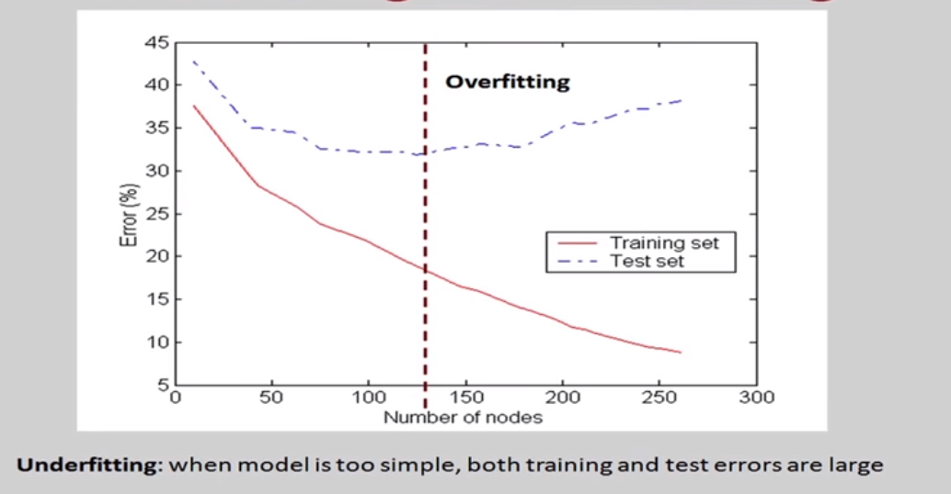
Underfitting and Overfitting

Slide 77
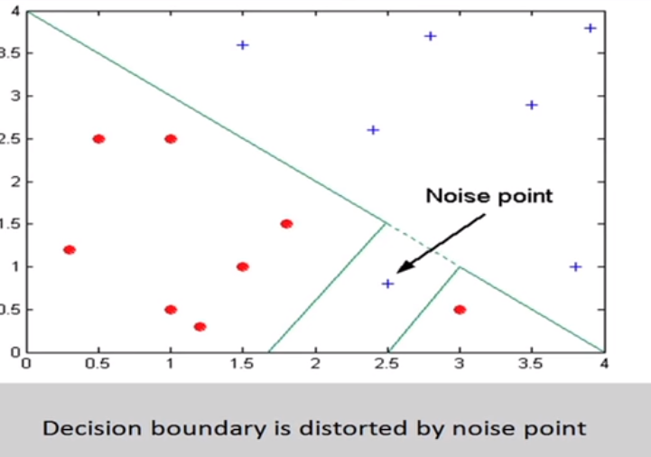
Overfitting due to noise

Slide 78
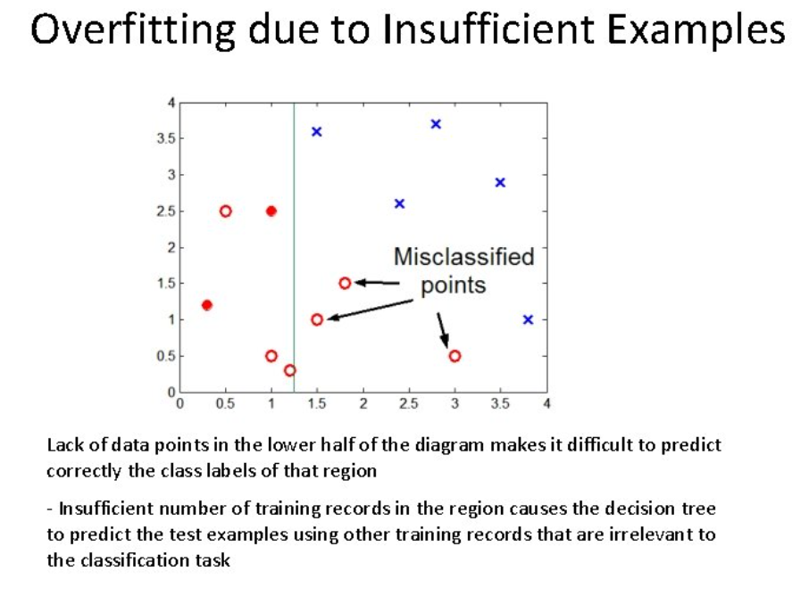

Slide 79
How to avoid overfitting in Decision trees
There are two types of methods used to prevent overfitting.
Pre-pruning type of methods and post-pruning type of methods.

Slide 80
Avoiding Overfitting
Two basic approaches
  Prepruning: Stop growing the tree at some point during construction when it is determined that there is not enough data to make reliable choices.
  Postpruning: Grow the full tree and then remove nodes that seem not to have sufficient evidence. (more popular)
Methods for evaluating subtrees to prune:
  Cross-validation: Reserve hold-out set to evaluate utility (more popular)
  Statistical testing: Test if the observed regularity can be dismissed as likely to be occur by chance
  Minimum Description Length: Is the additional complexity of the hypothesis smaller than remembering the exceptions ?
This is related to the notion of regularization that we will see in other contexts– keep the hypothesis simple.

Slide 81
Tree Pruning
When a decision tree is built, many of the branches will reﬂect anomalies in the training data due to noise or outliers
Tree pruning use statistical measures to remove the least reliable branches
Pruned trees tend to be smaller and less complex and, thus, easier to
comprehend
They are usually faster and better at correctly classifying independent test data than unpruned trees

Slide 82
How does Tree Pruning Work?
There are two common approaches to tree pruning: pre-pruning and post- pruning.
In the pre-pruning approach, a tree is “pruned” by halting its construction early (e.g., by deciding not to further split or partition the subset of training tuples at a given node).
When constructing a tree, measures such as statistical significance,
information gain, Gini index can be used to assess the goodness of a split.

Slide 83
How does Tree Pruning Work?
The post-pruning approach removes sub_trees from a “fully grown” tree
A subtree at a given node is pruned by removing its branches and replacing it with a leaf
The leaf is labelled with the most frequent class among the subtree being replaced (next slide)
For example, the subtree at node “A3?” in the unpruned tree of Figure 1.2
The most common class within this subtree is “class B”
In the pruned version of the tree, the subtree in question is pruned by
replacing it with the leaf “class B

Slide 84
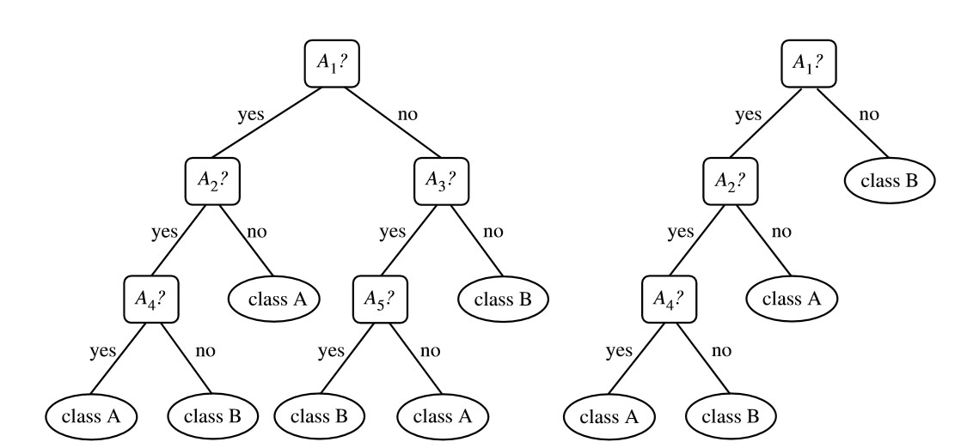
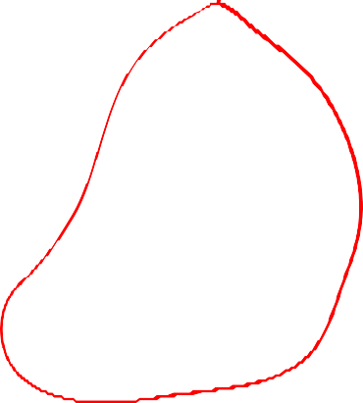
How does Tree Pruning Work?
Figure: 1.2 An unpruned decision tree and a post-pruned decision tree

Slide 85
Reduced-Error Pruning
A post-pruning, cross validation approach
  Partition training data into “grow” set and “validation” set.
  Build a complete tree for the “grow” data
  Until accuracy on validation set decreases, do: For each non-leaf node in the tree
Temporarily prune the tree below; replace it by majority vote. Test the accuracy of the hypothesis on the validation set Permanently prune the node with the greatest increase
in accuracy on the validation test.
Problem: Uses less data to construct the tree
Sometimes done at the rules level
General Strategy: Overfit and Simplify

Slide 86
Reduced Error Pruning ( a post pruning method)
Split data into train and validation set
Repeat until pruning is harmful
  Remove each subtree and replace it with majority class and evaluate on validation set
  Remove subtree that leads to largest gain in accuracy
train
validate
Tune
Tune
Test
Tune

Slide 87
Reduced Error Pruning Example
Outlook
Sunny
Rain
Overcast
Humidity
Wind
Play
Strong
Weak
High
Low
Don’t play
Play
Don’t play
Play
Full grown tree Validation set accuracy = 0.75

Slide 88
Reduced Error Pruning Example
Outlook
Sunny
Rain
Overcast
Don’t play
Wind
Play
Strong
Weak
Don’t play
Play
Validation set accuracy = 0.80

Slide 89
Reduced Error Pruning Example
Outlook
Sunny
Rain
Overcast
Humidity
Play
Play
High
Low
Don’t play
Play
Validation set accuracy = 0.70

Slide 90
Reduced Error Pruning Example
Outlook
Sunny
Rain
Overcast
Don’t play
Wind
Play
Strong
Weak
Don’t play
Play
Use this as final tree where Validation set accuracy = 0.80

Slide 91
Early Stopping
On training data
On test data
On validation data
Accuracy
Remember this tree and use it as the final classifier
0.9
0.8
0.7
0.6
Number of Nodes in Decision tree

Slide 92
When Are Decision Trees Useful ?
Advantages
  Very fast: can handle very large datasets with many attributes
  Flexible: several attribute types, classification and regression problems, missing values…
  Interpretability: provide rules and attribute importance
Disadvantages
  Instability of the trees (high variance)
  Not always competitive with other algorithms in terms of accuracy
92

